Slide 1
Los Adjetivos y Sustantivos

Slide 2
Adjectives in Spanish are like mirrors:
Nouns have gender and number in Spanish so the adjectives must reflect the same gender and number as its noun.
Adjective = Noun (in form)
In Spanish, adjectives are generally placed after the nouns. Only in a few cases, it will be placed before the nouns.

Slide 3
Examples:
El chico simpático
La chica simpática
Los chicos simpáticos
Las chicas simpáticas

Slide 4
Regular adjectives ending with –O
Adjectives that end in – o change to the feminine form by dropping the – o and adding – a;
They then change to the plural by adding – s to either form:
 | Masculine | Feminine
Singular | Alto | Alta
Plural | Altos | Altas

Slide 5
Adjectives ending with –e
The adjectives that end with –e in Spanish are are considered both masculine and feminine.
To make them plural, we are supposed to add –s to them.
 | Masculine | Feminine
Singular | Grande/Inteligente | Grande/Inteligente
Plural | Grandes/Inteligentes | Grandes/Inteligentes

Slide 6
Consonant ending adjectives
For adjectives that end with –or (consonant), we need to add –a to form the feminine.
For making these adjectives plural, we add –es to the masculine and –s to the feminine.
El estudiante trabajador
La estudiante trabajadora
Los estudiantes trabajadores
las estudiantes trabajadoras

Slide 7
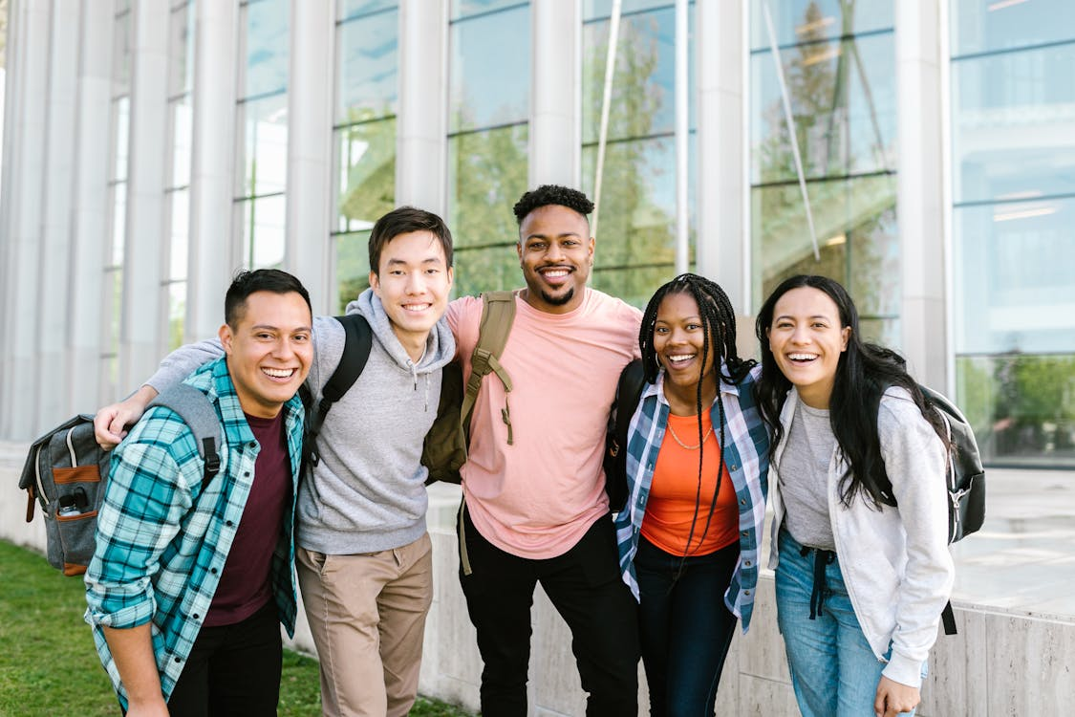
Adjectives that end in –z are considered both masculine and feminine.
For making these adjectives plural, we need to first change the –z to –c and then add –es to form the plural. For e.g.
El estudiante feliz
La estudiante feliz
Los estudiantes felices
Las estudiantes felices

Slide 8
Adjectives ending with a consonant (except –or and –z ending) are used for both genders. They are changed to plural forms by adding –es.
 | Masculine | Feminine
Singular | Fácil | Fácil
Plural | Fáciles | Fáciles

Slide 9
Adjectives of Nationality
Nationality as an adjective, changes with gender and number. If it ends with a consonant, then we add –a to make it feminine. For e.g.
El chico japonés
La chica japonesa
El libro alemán
La revista alemana
El restaurante español
La cafetería española

Slide 10
If the nationality ends with the letter –o then we replace it with –a to make it feminine.
Un chico Italiano
Una chica italiana
Un chico ruso
Una chica rusa
Un restaurante indio
Una chica india

Slide 11
Nouns having more than one adjective:
If more than one adjective modifies and follows a noun, you may connect them with the conjunction –y:
Una muchacha/chica simpática y bonita
Yo soy una chica inteligente, interesante, guapa y alta.
Un muchacho/chico alto y gordo.

Slide 12
Remember that in Spanish, whether it follows or precedes the noun, the adjective must match the noun in gender and number:
N
(Adj)
(Adj)
=
=
xy
xy
xy
Adj = adjective
N= noun
X = masculine or feminine
Y = singular or plural

Slide 13
Exercises
cubanos
Los turistas son ____________. (cubano)
Las calles son ____________. (ancho)
Las lecciones son ____________. (fácil)
Las sillas son ____________. (cómodo)
Tú eres gracioso y las señoritas son ______ también.
El tango es argentino y los gauchos son ______ también.
Las clases son difíciles y el curso es _______ también.
anchas
fáciles
cómodas
graciosas
argentinos
difícil

Slide 14
Summary
The basic concepts related to adjectives and their placement with nouns in Spanish.
Regular adjectives ending with -o.
Adjectives ending with -e.
Different types of consonant ending adjectives. For eg. -or ending, -z ending.
Adjectives of nationality in Spanish and its uses.

